Slide 1
Background Tasks with Worker Service

Slide 2
Objectives
Overview Worker Service .NET
How to implement a Background Task by Worker Service
Overview Windows Service
Demo create Worker Service to consume ASP.NET Core Web API
Demo to publish Worker Service as a Windows Service

Slide 3
Overview Worker Service .NET

Slide 4
Understanding Worker Service .NET
A worker service is a .NET project built using a template which supplies a few useful features that turn a regular console application into something more powerful
A worker service runs on top of the concept of a host, which maintains the lifetime of the application. The host also makes available some familiar features, such as dependency injection, logging and configuration
Worker services will generally be long-running services, performing some regularly occurring workload such as:
Processing messages/events from a queue, service bus or event stream
Reacting to file changes in an object/file store
Aggregating data from a data store
Enriching data in data ingestion pipelines
Formatting and cleansing of AI/ML datasets

Slide 5
Understanding Worker Service .NET
It’s also possible to develop a worker service which performs a process from start to finish and then shuts down. Coupled with a scheduler, this can support periodical batch workloads
For example, every hour the service is started by the scheduler, calculates some aggregate totals and then shuts down
Worker services do not have a user interface, nor will they support direct user interaction. They are particularly applicable when designing a microservices architecture. Here responsibilities are often split into distinct, separately deployable and scalable services

Slide 6
Understanding Worker Service .NET
Use a host to maintain the lifetime of the console application until the host is signalled to shut down. Turning a console application into a long-running service
Include features common to ASP.NET Core such and dependency injection, logging and configuration
Perform periodic and long-running workloads
Background tasks can be implemented in two ways: Implementing IHostedService Interface and Inheriting BackgroundService Class

Slide 7
The BackgroundService Class
BackgroundService is an abstract base class for implementing a long-running IHostedService. Using BackgroundService class we can write less code as compared to IHostedService
The following table describes some of the key methods:
Method | Description
StartAsync(CancellationToken) | Triggered when the application host is ready to start the service
StopAsync(CancellationToken) | Triggered when the application host is performing a graceful shutdown
Dispose() | Performs application-defined tasks associated with freeing, releasing, or resetting unmanaged resources
Equals(Object) | Determines whether the specified object is equal to the current object. (Inherited from Object)
ExecuteAsync(CancellationToken) | This method is called when the IHostedService starts. The implementation should return a task that represents the lifetime of the long running operation(s) being performed

Slide 8
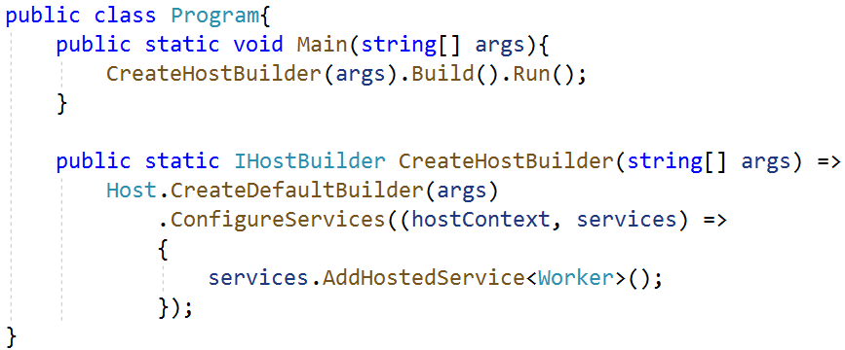
The Worker Service Template Provide
The worker service template includes useful foundational components, like dependency injection, by default so that we can focus on building our business logic on top. It includes a host which manages the lifecycle of the application
The worker service template is reasonably basic and includes just three core files:
Program.cs: The first of which is a Program class. This class consists of the required Main method entry point for .NET console applications. The .NET runtime expects to locate this method within the Program class when it starts your .NET application

Slide 9
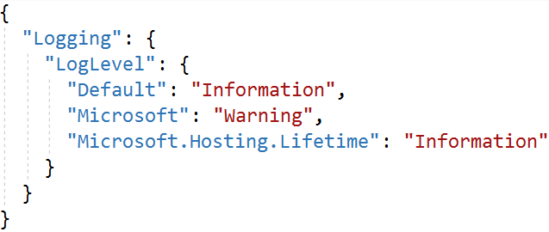
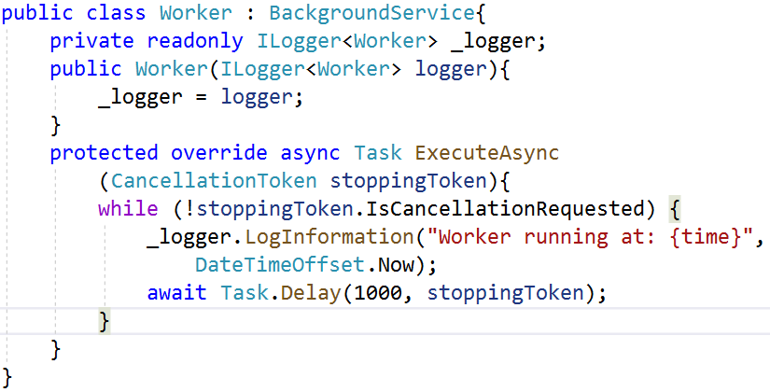
The Worker Service Template Provide
appsettings.json: It is one of the common sources for application configuration. The host is configured to load application configuration from several sources when the application starts using any registered configuration providers
Worker.cs: The Worker class is something new which you will not find in the default ASP.NET Core project template. This is where the magic of hosted services, combined with the host, provide the basis of a worker service

Slide 10
Demo 01: Create a Worker Service using Visual Studio.NET

Slide 11
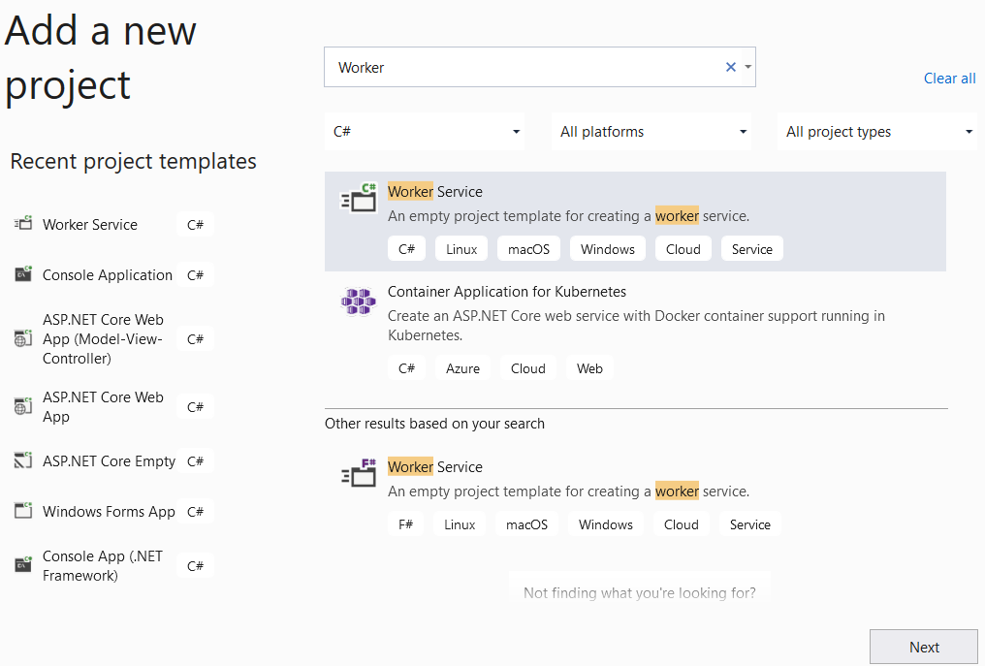
1. Open Visual Studio.NET , File | New | Project
1
2
3

Slide 12
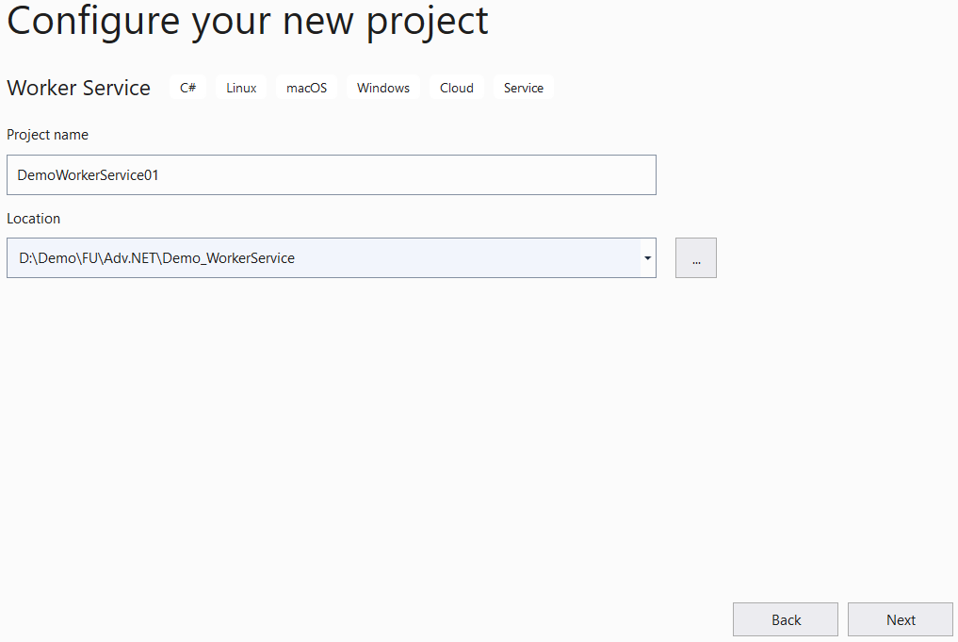
2. Fill out Project name: MyWPFApp and Location then click Next
4
5

Slide 13
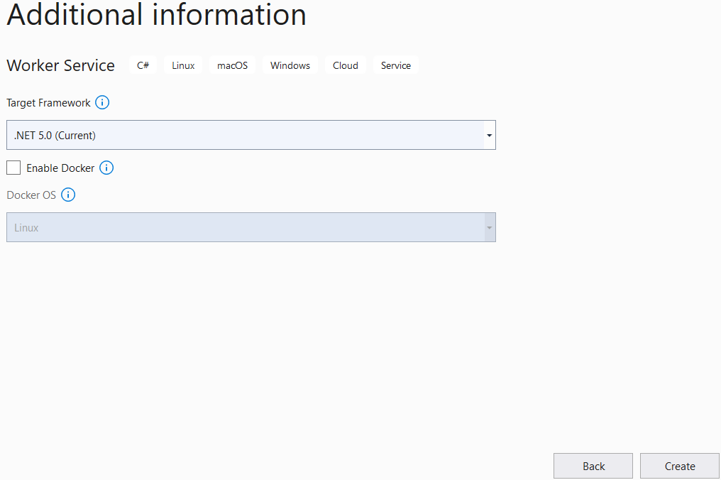
3. Choose Target Framework: .NET 5.0 (Current) then click Create
6
7

Slide 14
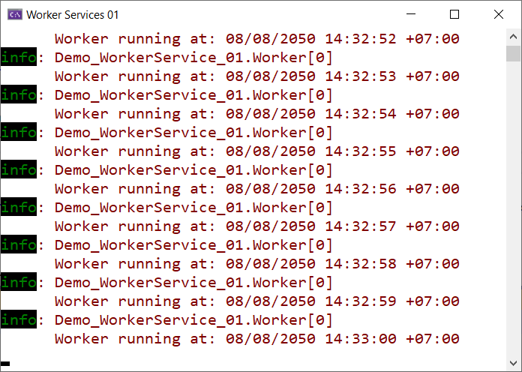
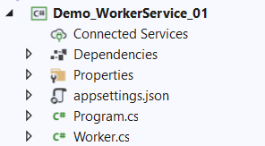
4. Run the project

Slide 15
Demo 02: Worker Service and Web API

Slide 16
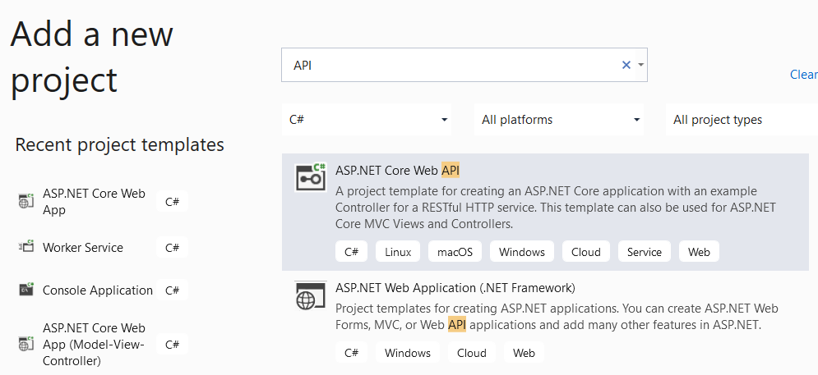

Worker Service Demo-02
Create a background task that use HttpClient to call a API service to retrieve the current exchange rate between various currencies, and print the result
1.Open the Visual Studio.NET then create ASP.NET Web API Project named ExchangeRateService
1
2

Slide 17
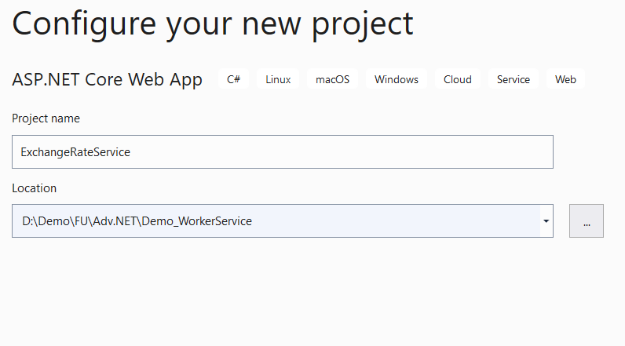

Worker Service Demo-02
3
4

Slide 18
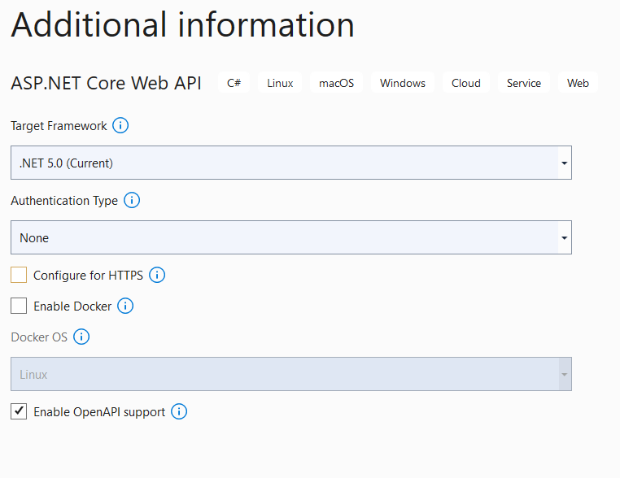

Worker Service Demo-02
5
6

Slide 19
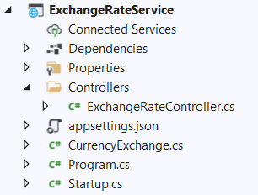
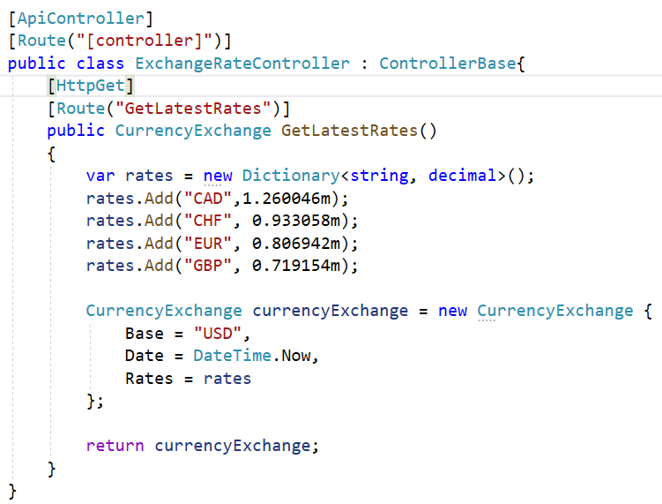
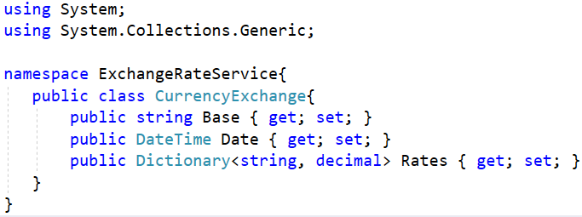
2.Write codes for the ExchangeRateService project as follows:

Slide 20
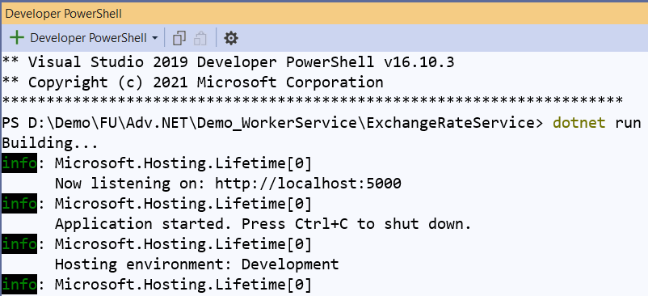
3. Right-click on the project, select Open in Terminal. On Developer PowerShell dialog, execute the following command to run Web API project

Slide 21
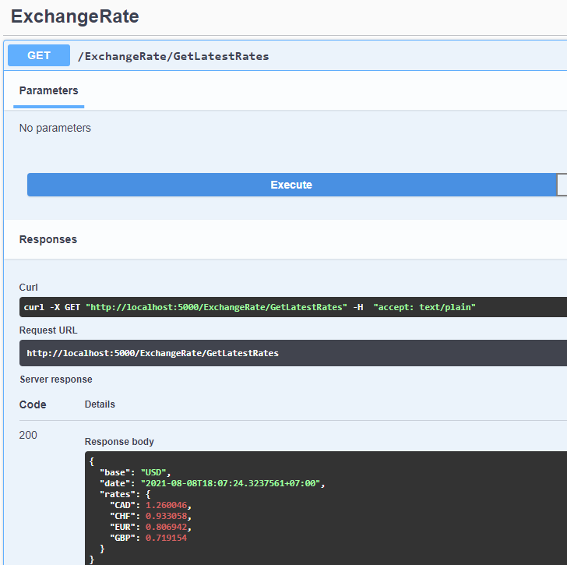
4. Open the web browser and enter the following link to test GetLatestRates method with Swagger : http://localhost:5000/swagger/index.html

Slide 22
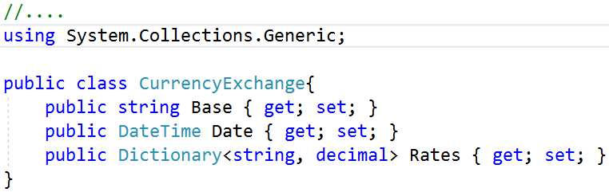
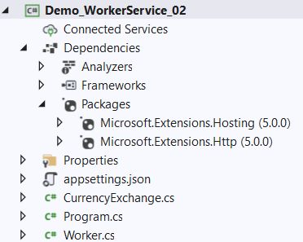
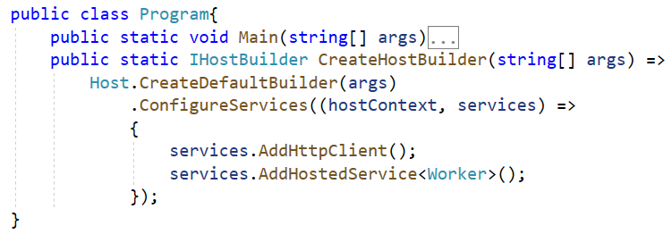
5. Create Worker Service Project named DemoWorkerService02 to consume ExchangeRateService project
6. Install Microsoft.Extensions.Http package from NuGet
7. Write codes for CurrencyExchange.cs and Program.cs as follows:

Slide 23

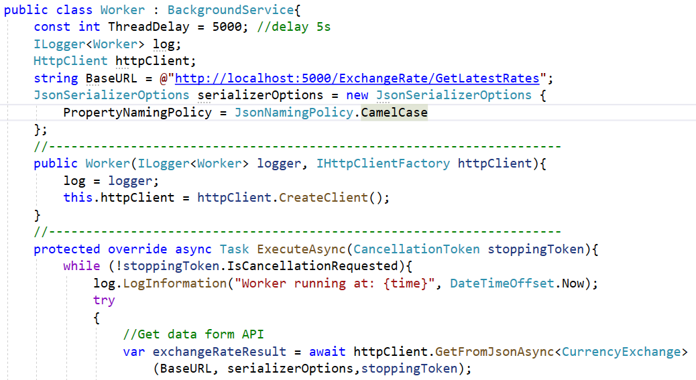
8. Write codes for Worker.cs as follows:

Slide 24
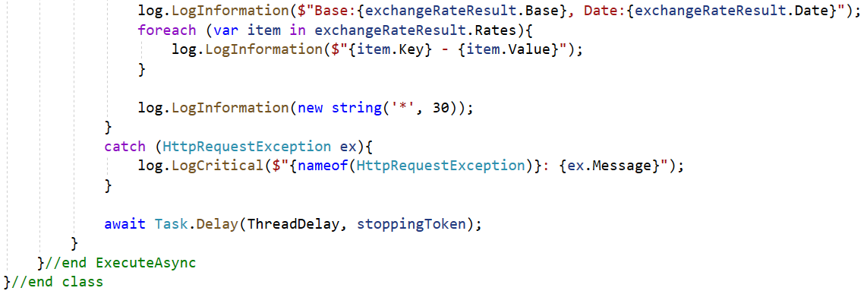
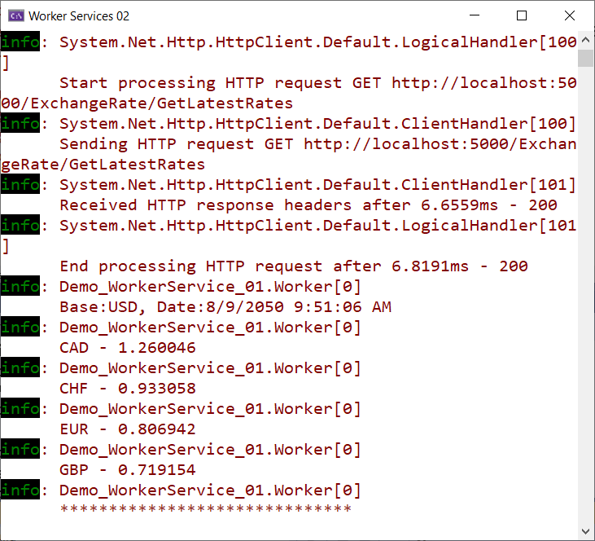
9. Run DemoWorkerService02 project

Slide 25
Introduction to Windows Service
Microsoft Windows services, formerly known as NT services, enable us to create long-running executable applications that run in their own Windows sessions
These services can be automatically started when the computer boots, can be paused and restarted, and do not show any user interface
These features make services ideal for use on a server or whenever we need long-running functionality that does not interfere with other users who are working on the same computer
We can also run services in the security context of a specific user account that is different from the logged-on user or the default computer account

Slide 26
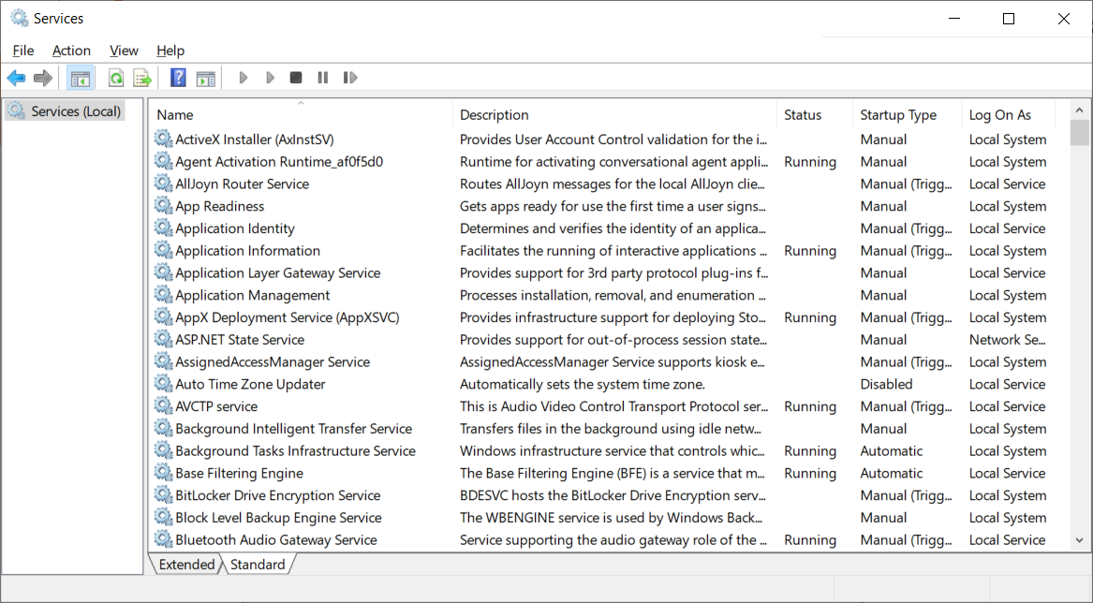
Introduction to Windows Service

Slide 27
Windows Service and Systemd on Linux
.NET Framework developers are probably familiar with Windows Service apps
Before .NET Core and .NET 5+, developers who relied on .NET Framework could create Windows Services to perform background tasks or execute long-running processes
This functionality is still available and we can create Worker Services that run as a Windows Service on Windows and Systemd on Linux

Slide 28
Demo 03: Publish a Worker Service as a Windows Service

Slide 29
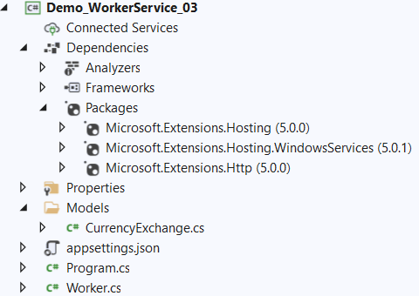
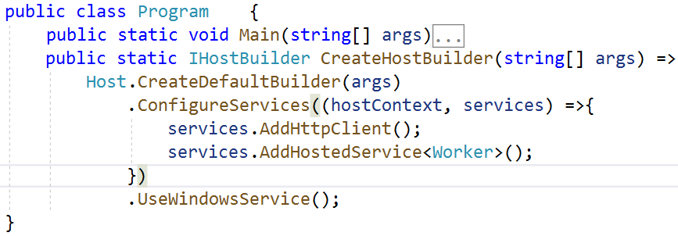
1.Create Worker Service Project named DemoWorkerService03 to consume ExchangeRateService project (refer to Demo 02)
2.Install Microsoft.Extensions.Http and Microsoft.Extensions.Hosting.WindowsServices package from NuGet
3.Write codes for CurrencyExchange.cs and Program.cs as follows:

Slide 30
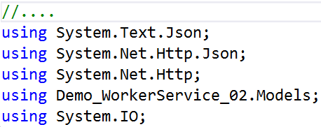
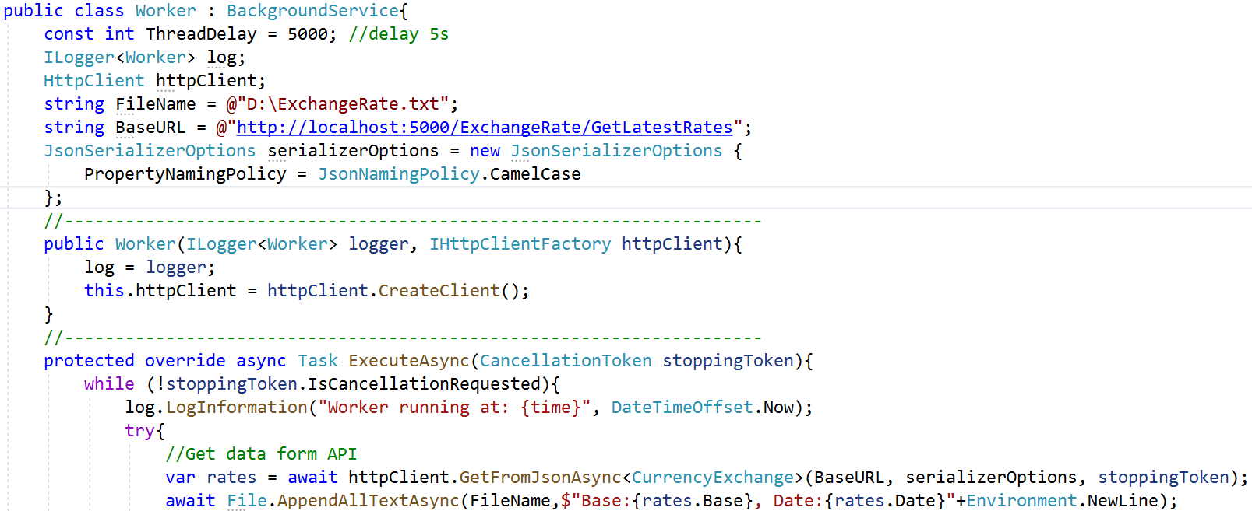
4. Write codes for Worker.cs as follows:

Slide 31
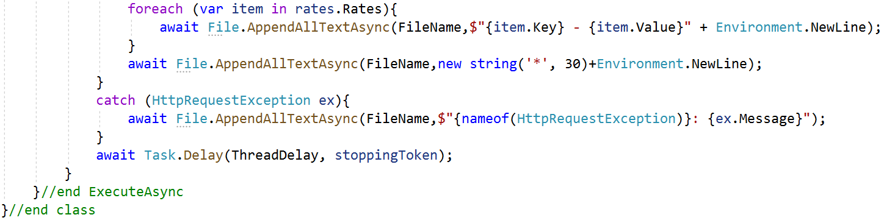
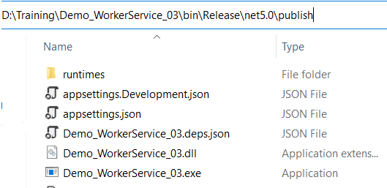
5. Right-click on the project, select Open in Terminal. On Developer PowerShell dialog, execute the following command to publish project :
dotnet publish -c Release

Slide 32
6. Right-click on the ExchangeRateService project, select Open in Terminal. On Developer PowerShell dialog, execute the following command to run Web API project

Slide 33
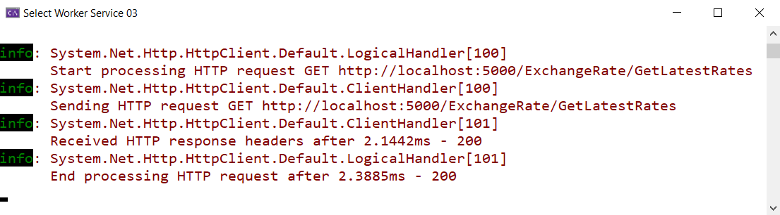
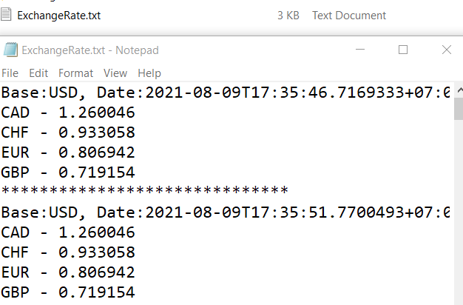
7. Run DemoWorkerService03 project , then view ExchangeRate.txt file

Slide 34
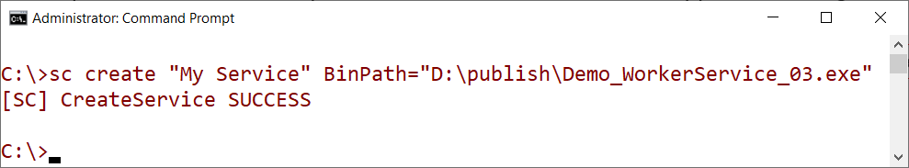
8. Create Windows Service from DemoWorkerService03 project
Open a Command Prompt as Administrator, and install the application using the Windows sc utility ( refer to publish folder in Step 5)
sc create "My Service" BinPath="D:\publish\Demo_WorkerService_03.exe"

Slide 35
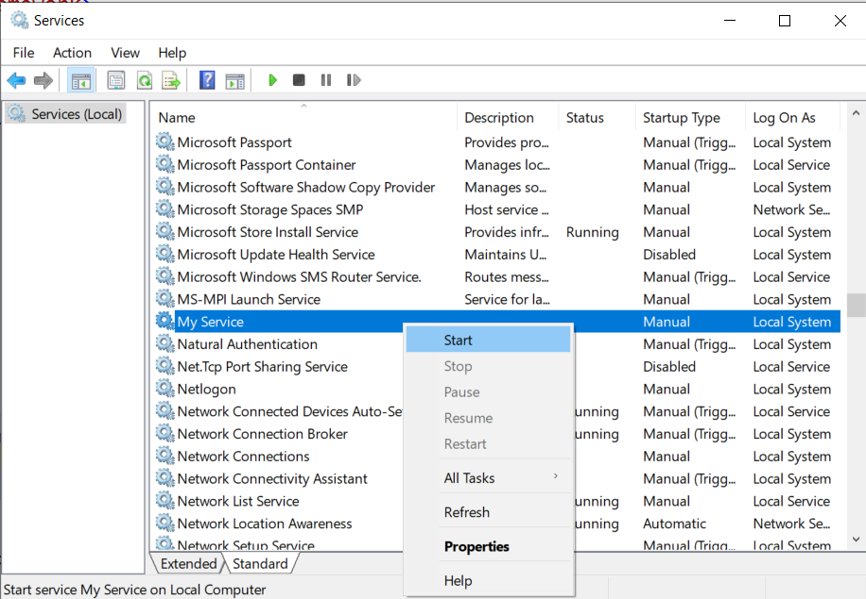
9. Open Services dialog from Control Panel | All Control Panel Items | Administrative Tools and select “My Service” then right-click | press Start to start service

Slide 36
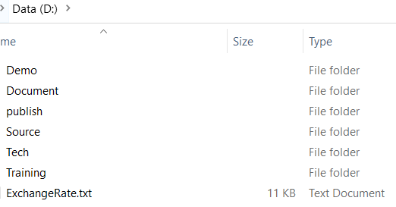
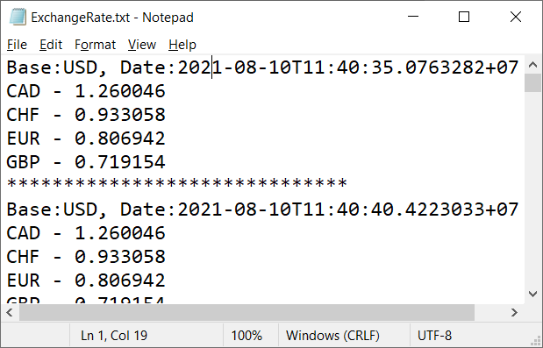
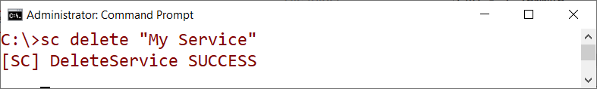
10. Open ExchangeRate.txt file to view data. The file size will increase every 5 seconds
11. Stop “My Service” and use the following command to remove it :

Slide 37
Summary
Concepts were introduced:
Overview Worker Service .NET
How to implement a Background Task by Worker Service
Overview Windows Service
Demo create Worker Service to consume ASP.NET Core Web API
Demo to publish Worker Service as a Windows Service

